Slide 1

WELCOME
ERP TRAINING
October 23,2024

Slide 2

Welcome & Introductions
Upgrade Schedule
Security Request & Signature Authorization Form
OKTA login and navigation
Hub Customization
Wild Card Searches
Database Locks
Future state of ERP
ERP support email erpsupport@franklincountyohio.gov

Slide 3
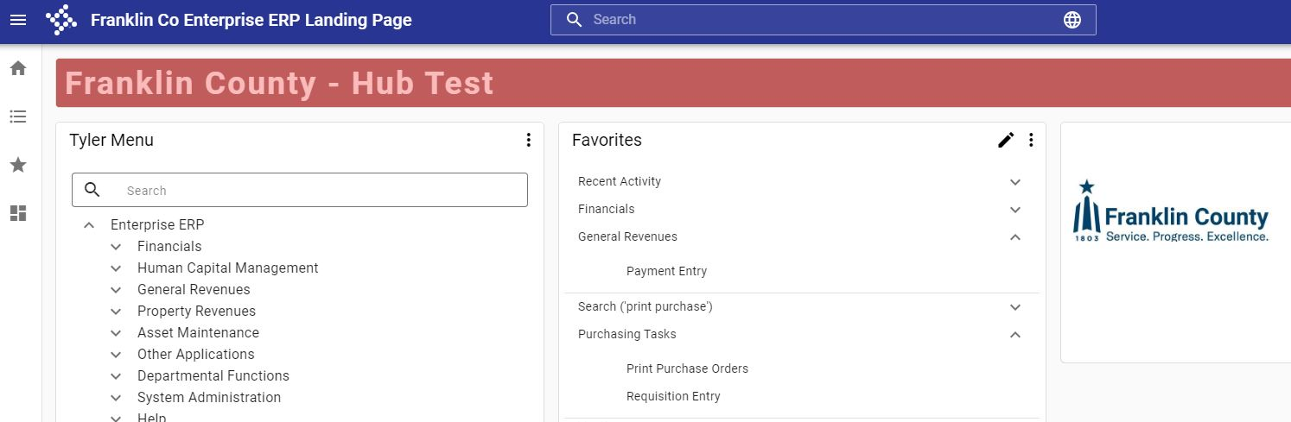
Upgrades
ERP (production) will upgrade from Version: 2021.10 to Version: 2024.2 the evening of November 1.
We plan to upgrade annually in the Fall; this will align with our workload and training schedule.
https://franklincountyoh-test.tylerhub.com/
Test is on upgraded version 2024.2
Notes:
In order for continued support from the vendor, we will need to update our ERP version regularly. Tyler Technologies has moved to a quarterly update cadence. We have decided to upgrade once a year in the fall to keep current.
Now that we are cloud hosted and on the web platform, updates will be easier to implement and should be easier for users to digest. Think of upgrades as “service packs”, a collection of bug fixes and enhancements. We will highlight major changes when noted.
We always encourage agencies to test upcoming versions themselves at https://franklincountyoh-test.tylerhub.com/ We test ourselves, but we may not always be aware of unique processes or reports that an agency relies upon.

Slide 4
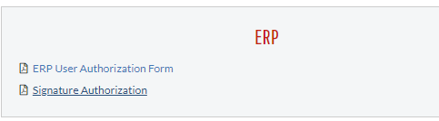
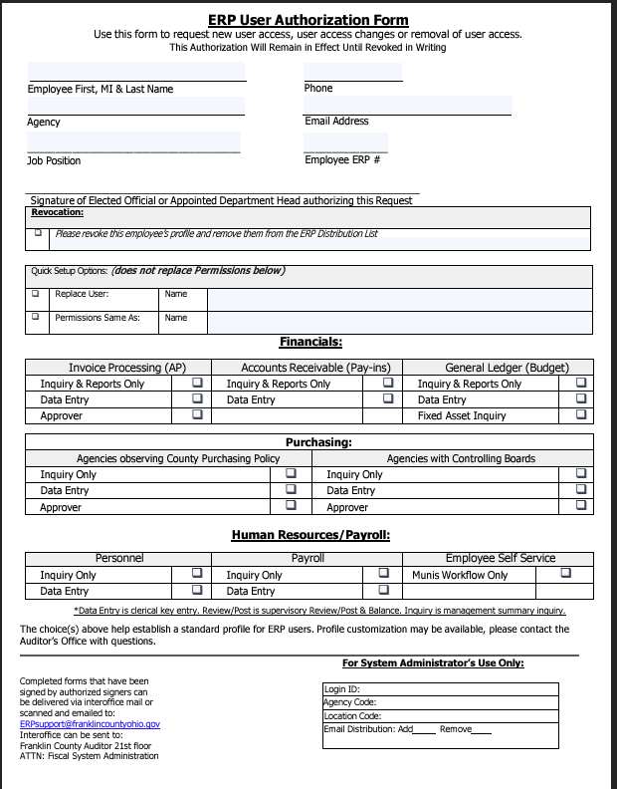
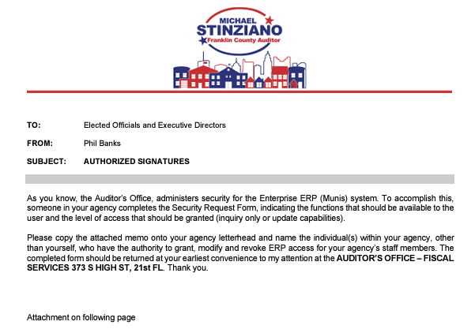
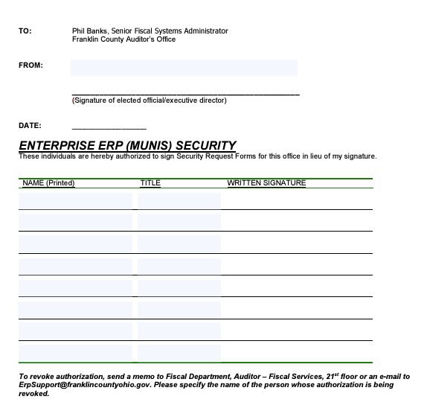
Security Request &
Signature Authorization Form
Located in Form Center on Fiscally Speaking
  https://www.franklincountyauditor.com/fiscal/fiscally-speaking/form-center

Slide 5
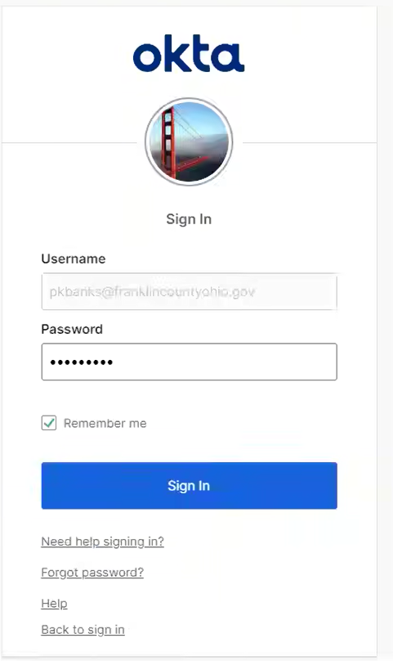
Login
Login process is unchanged. Use any browser (Chrome preferred) to : https://franklincountyoh.tylerhub.com/
Login will always require to Verify with Email Authentication. Okta , Titled: One-time verification code You will need to copy or note the 6 digit code for verification.
Forgot Password? Try Need help signing in link followed by forgot password link or you can email erpsupport@franklincountyohio.gov to request pw reset.
Notes:
Passwords expire after 120 days
Users get prompted 5 days before password expires
Password requires 8 characters including lowercase, uppercase, number, symbol and no part of first or last name.

Slide 6
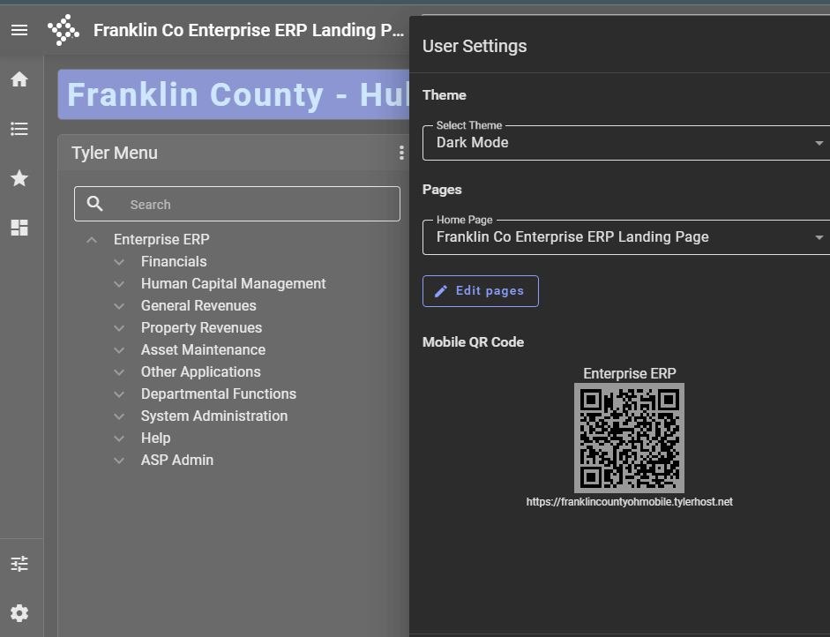
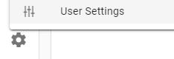
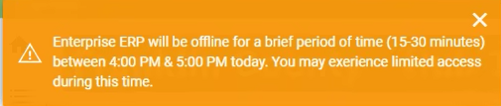
Customize the Hub
Easily change from Light mode (default) to Dark mode
Announcements
Easily change from Light mode (default) to Dark mode
Notes:
Hub can be customized to go in dark mode using the gear icon and ‘User Settings’ Additionally, users can add cards to their landing page. Cards give the ability to drill down to a quick view of data that the user works with. The vendor has built-in cards to use as templates, your mileage may vary.

Slide 7
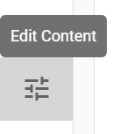
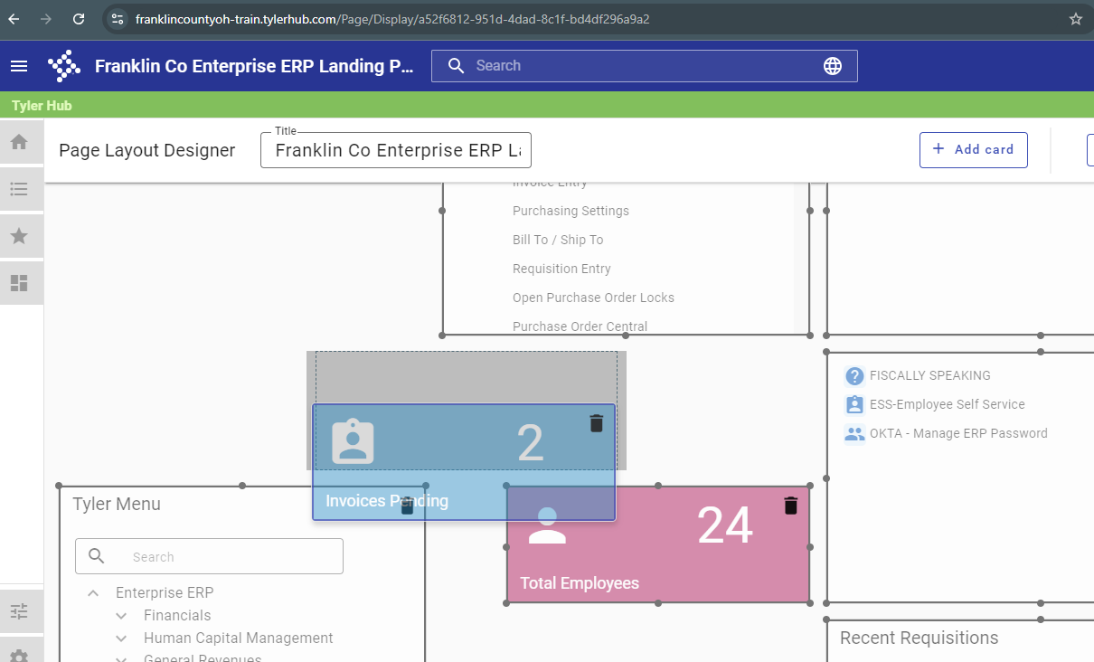
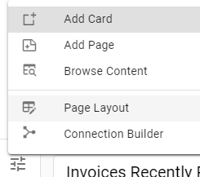
Edit Content button can be used to resize, move, add or delete content on the Hub page
Notes:
Cards can contain data,

Slide 8
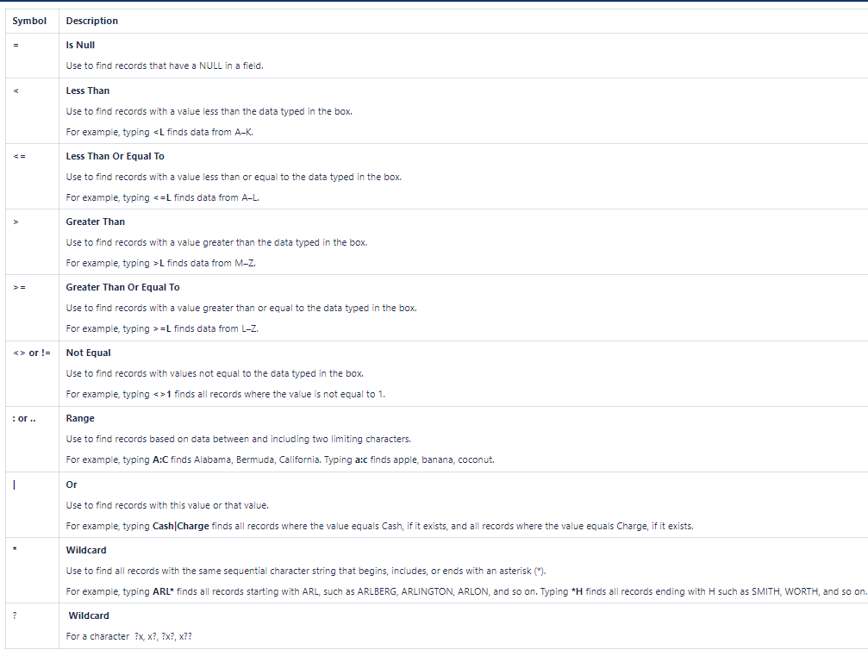
Wildcard Searches
Notes:
Cards can contain data,

Slide 9
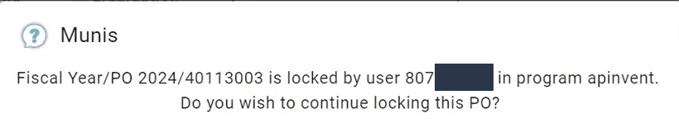

Database Locks
Do you ever get this message?
This is most caused from exiting the program incorrectly. Make sure that you are using X (Close) from the ERP menu and NOT closing from the browser tab.
Send email to: Audr-AP@franklincountyohio.gov
and or erpsupport@franklincountyohio.gov to have PO unlocked
Notes:
P.O. locks are a mechanism to prevent over-liquidation of a Purchase Order. Anytime you are working in a P.O., the database puts a lock on it so that only one user can be in it. This prevents you from over-liquidating a Purchase Order that someone else might be keying to. If you close out of the program by closing the browser tab or shutting down the computer, the lock will stay on indefinitely. Try to finish your work and close with the ERP menu Close button to prevent this. Closing incorrectly can also lead to locks in other areas such as Pay-In batches.

Slide 10
What is coming?
More Workflow
Single Sign On
What would you like to see?
Notes:
Future initiatives of Enterprise ERP:
Increased use of workflow and TCM. The plan is to move to paperless wherever we can. Pay-Ins, Journal Entries, etc.
Single Sign-On? Currently working with the Franklin County Data Center to upgrade and allow
Continue to use the ERPSupport email.

Slide 11

Questions?
ERPSupport@franklincountyohio.gov

